Slide 1

Predicting Student Success to Provide Preemptive Intervention
/CristinaTRico

Slide 2
The Data
The Basics
The Goal
395 Data Points
30 Features
13 Binomial
4 Nominal
11 Ordinal
2 Continuous
Imbalanced Target
68% Passed
32% Failed
Identify students that are at risk of failing a course to provide them with preemptive intervention

Slide 3
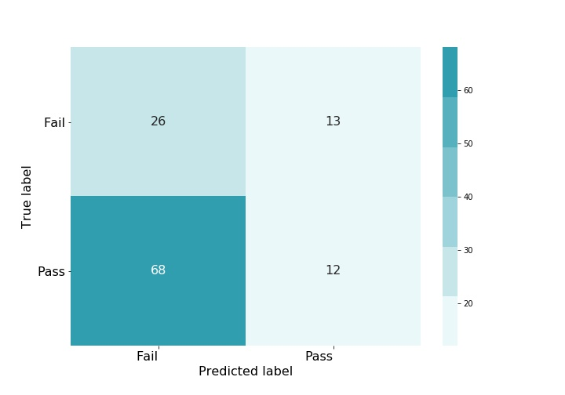
How would educators address this issue without machine learning?
Results:

Slide 4
The Process: Baseline
VTreat
Model
Preprocessing
Feature Selection
Failures
Go Out
Two features created from the variable Higher
Logistic Regression Model

Slide 5
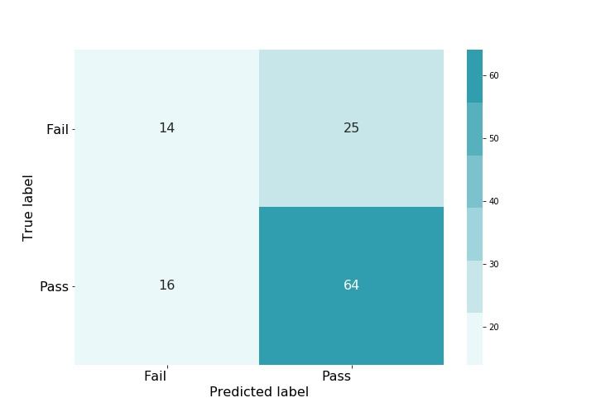
The Process: Baseline
Results:
AUC = 0.6162

Slide 6
The Process: Final Models
Splitting the Data
Target encoded training data
Used scikit-learn’s Select From Model with a Lasso Logistic Regression Model for feature selection
Logistic Regression Model for final classification
Male
Female
Seven Selected Features:
Mother’s Education Level
Father’s Education Level
Failures
School Support
Going Out
Weekday Drinking
Absences Binned
Twenty Five Selected Features
Age
Address
Family Size
Parent Status
Mother’s Job
Father’s Job
Reason
Guardian
Travel Time
Study Time
Failures
School Support
.
Paid
Activities
Nursery
Higher
Internet
Romanic
Family Relationship
Free Time
Going Out
Weekend Drinking
Health
Absences Binned

Slide 7
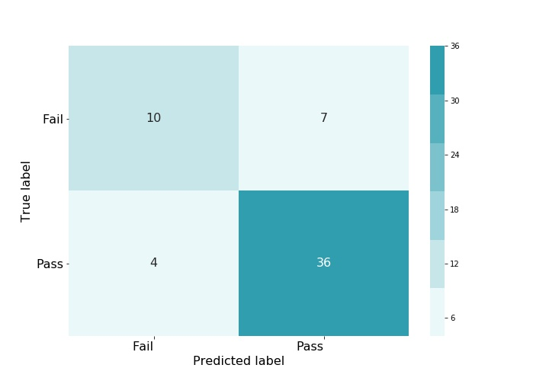
Results: Male Model
Results:
AUC = 0.7441

Slide 8
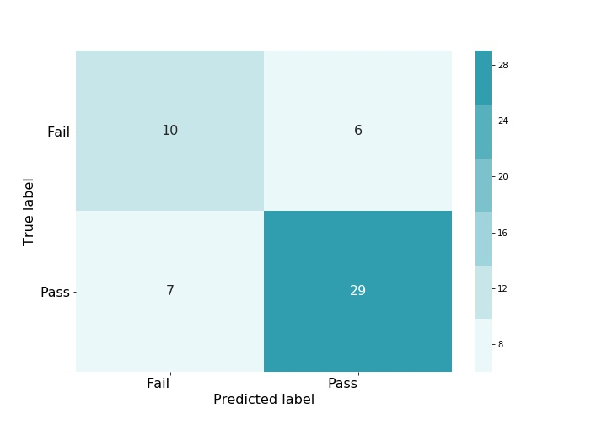
Baseline Results for Males
Final Results for Males
AUC = 0.7152
AUC = 0.7441

Slide 9

Results: Female Model
Results:
AUC = 0.6216

Slide 10
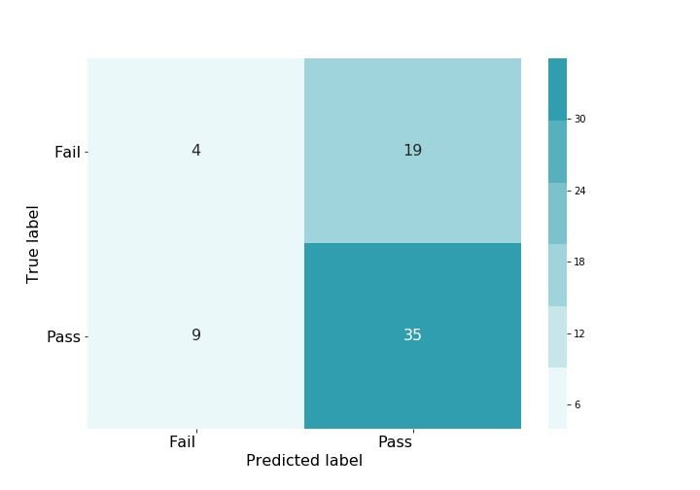
Baseline Results for Females
Final Results for Females
AUC = 0.4847
AUC = 0.6216

Slide 11
Questions?

